Slide 1




PocketCred
Verifiable Credentials
$$™️$$
PRESENTED BY

Slide 2
WHO WE ARE
2013 | 2016 – 2017 | 2018 – 2019 | 2020-2021
⚫ | ⚫ | ⚫ | ⚫
Pravici founded. Focus: CRM & Loyalty | Started Blockchain practice | Established industry leadership | Pravici 2020-2021 focus areas:
Started by former Oracle colleagues Focus on CRM Implementations Deep expertise and experience in Customer Loyalty, Transportation, Captive Finance domains Oracle Gold Partner Salesforce ISV Partner | 2016 Developed Tokenized Loyalty Points (TLP) Blockchain offering as an adjunct to ANY existing Loyalty Platform 2017 Ethereum POC delivered for largest NA Auto OEM Challenge Deep integration with Oracle products - Oracle Blockchain as service, CrowdTwist and Siebel Loyalty | JANUARY 2018 Joined Hyperledger Association MAR 2018 Joined MOBI Auto Consortium NOV 2018 First Pravici Loyalty Blockchain to production pilot with large NA Auto OEM NOV 2019 Winner of 4 awards in MOBI Citopia, including Overall Champion TLP Available in the Oracle product Marketplace | Apply TLP and Decentralized ID concepts to mitigate impact of COVID-19 – Introducing PocketCred Enhance next-generation TLP Loyalty offering Privacy and Security using verifiable Credentials Loyalty Points as currency to acquire customer info Support for multiple languages Multi-point loyalty with point exchange

Slide 3











PRAVICI LLC
TOOLS & PARTNERS
LOYALTY PLATFORMS | BLOCKCHAIN TOOLS | PRODUCTS
SeAmLeSs
Connector for
SMS marketing
Salesforce Loyalty
PARTNERS & ASSOCIATIONS

Slide 4


Pravici PocketCred
  Issue privacy preserving Verifiable Credentials, which can store a credential in digital form in a consumer’s cell phone and can be verified by a verifier through software.

Slide 5
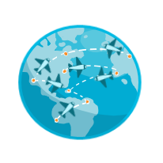
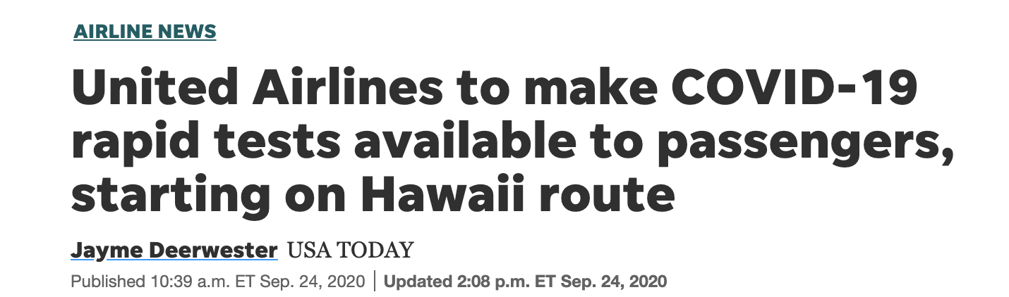

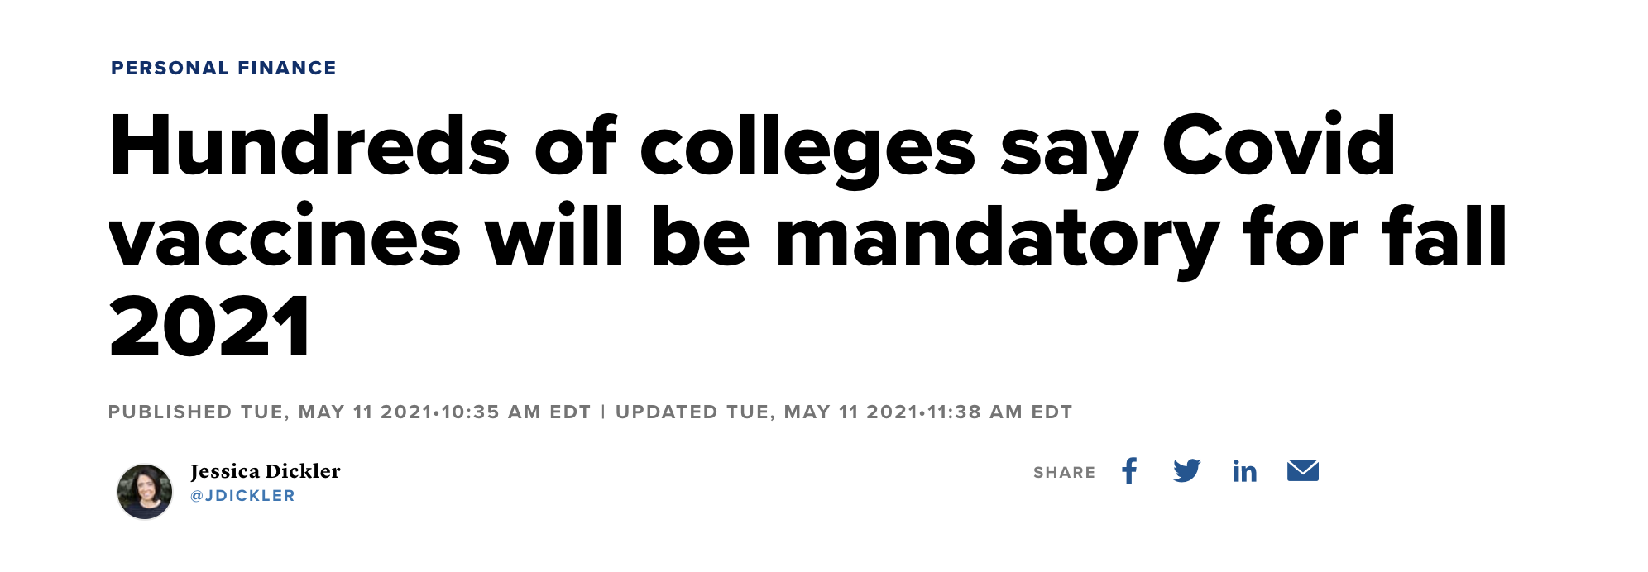
Safely bring customers/employees back on-board & on-site
Now that a vaccine is available, can we give a differentiated experience for those customers who have taken a vaccine ?
Can we let employees come to work without expensive day-to-day testing?

Slide 6
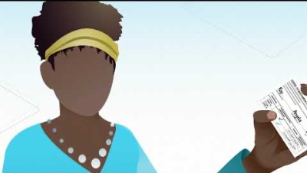
Pravici PocketCred – How it works

Slide 7
Credential Options
Option1: SMART Health Cards – Such as the one issued by the State of California; You can get one at https://myvaccinerecord.cdph.ca.gov/
Option2: Verifiable Credentials – “The Full Monty”; DID COMM, Verifiable Presentation, Selective Disclosure, Zero Knowledge Proofs using BBS+/CL Signatures
For Option 2, we use Evernym Agents

Slide 8
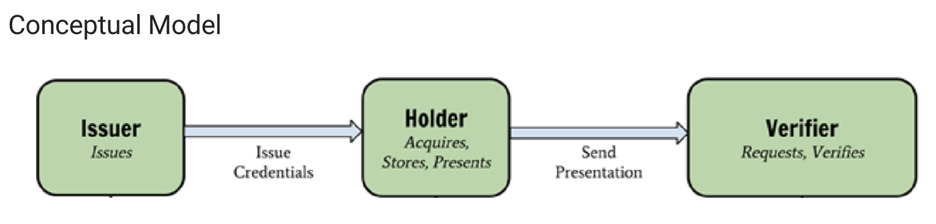
SMART Health Cards
Support end-to-end workflow where users receive and present relevant healthcare data
Enable workflow with open standards - The Health Cards framework serializes VCs using the compact JWS serialization, where the payload is a compressed set of JWT claims
Support strong cryptographic signatures - Elliptic Curve keys using the P-256 curve
Enable privacy preserving data presentations for specific use cases – Covid – 19 Vaccine data
Jason

Slide 9
SMART Health Cards – VC Structure
{ "iss": "<<Issuer URL>>",
"nbf": 1591037940,
"vc": {
"type": [ "https://smarthealth.cards#health-card", "<<Additional Types>>", ],
"credentialSubject": {
"fhirVersion": "<<FHIR Version, e.g. '4.0.1'>>",
"fhirBundle":{
"resourceType": "Bundle",
"type": "collection",
"entry": ["<<FHIR Resource>>", "<<FHIR Resource>>", "..."]
} } } }
Jason

Slide 10
SMART Health Cards – VC Structure
To ensure that all Health Cards can be represented in QR codes, issuers SHALL ensure that the following constraints apply at the time of issuance:
JWS Header
  header includes alg: "ES256"
  header includes zip: "DEF"
  header includes kid equal to the base64url-encoded SHA-256 JWK Thumbprint of the key (see RFC7638)
JWS Payload
  payload is minified (i.e., all optional whitespace is stripped)
  payload is compressed with the DEFLATE (see RFC1951) algorithm before being signed (note, this should be "raw" DEFLATE compression, omitting any zlib or gz headers)
  payload .vc.credentialSubject.fhirBundle is created
Jason

Slide 11
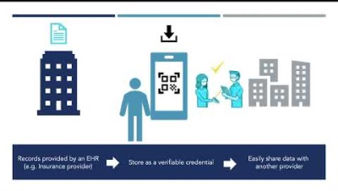
SMART Health Cards – Example
Kevin

Slide 12
SMART Health Cards – Verification
Issuers sign Health Card VCs (Verifiable Credentials) with a signing key (private key)
Issuer publish the corresponding public key (public key) at /.well-known/jwks.json
Wallets and Verifiers use the public key to verify Issuer signatures on Health Cards
Kevin

Slide 13
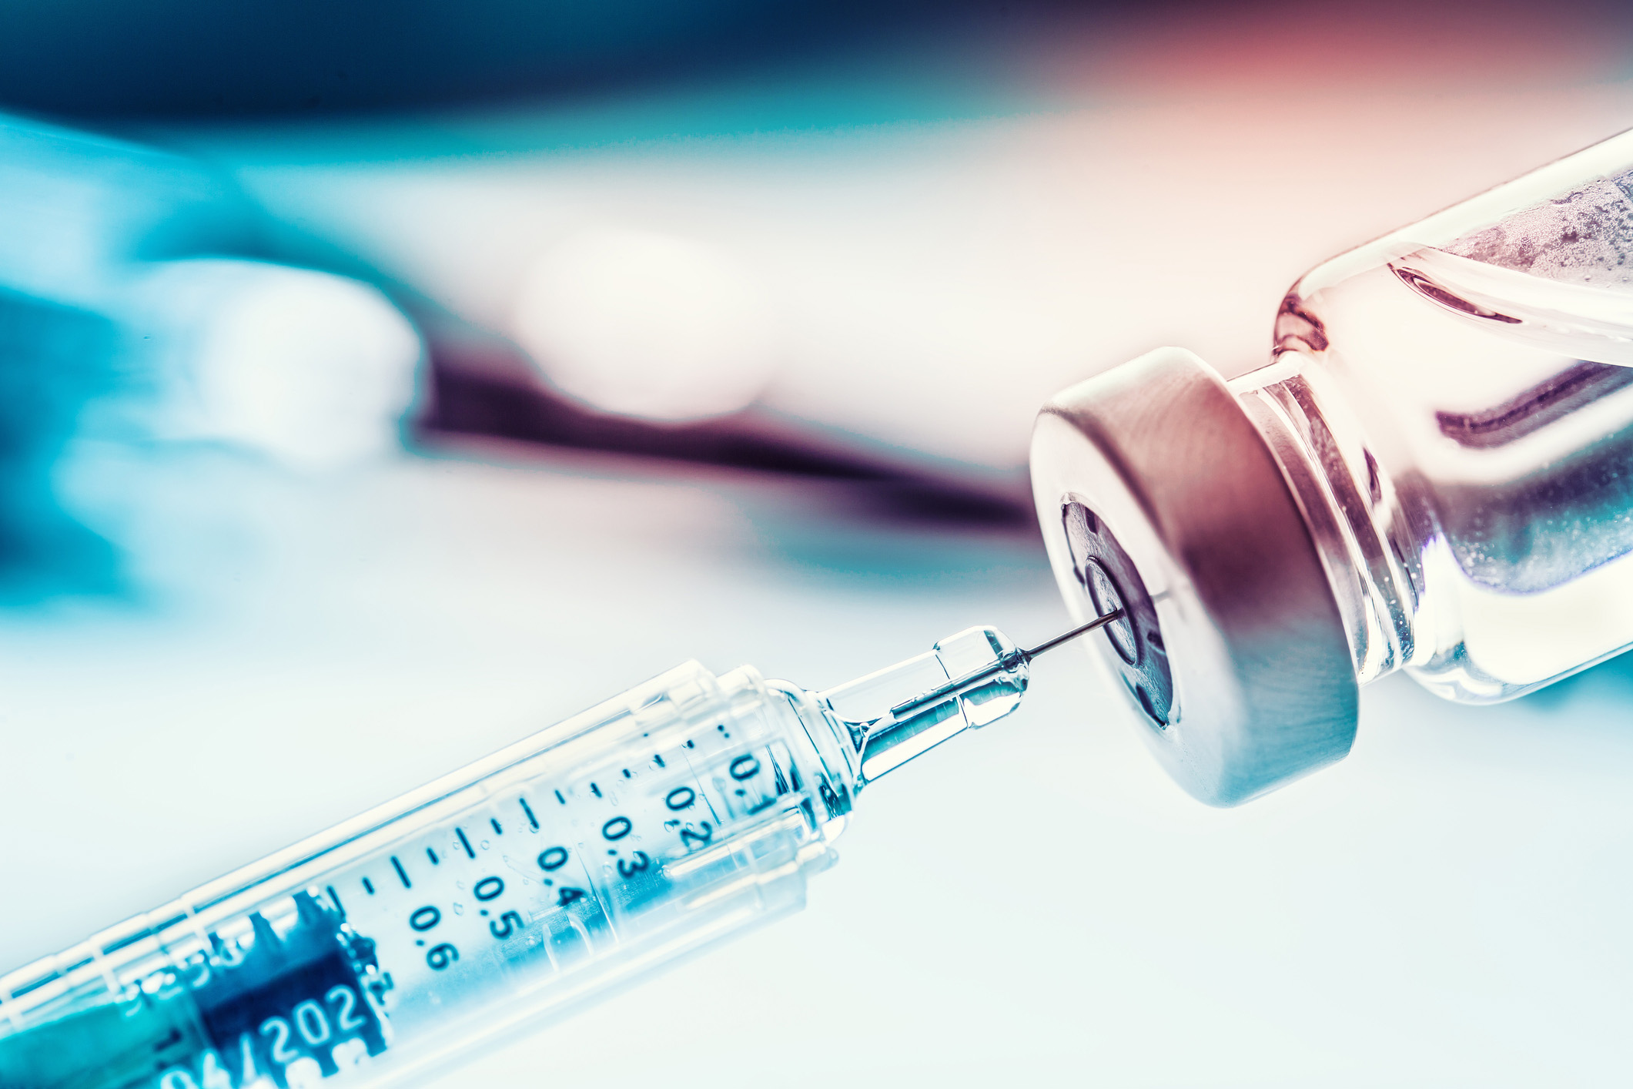
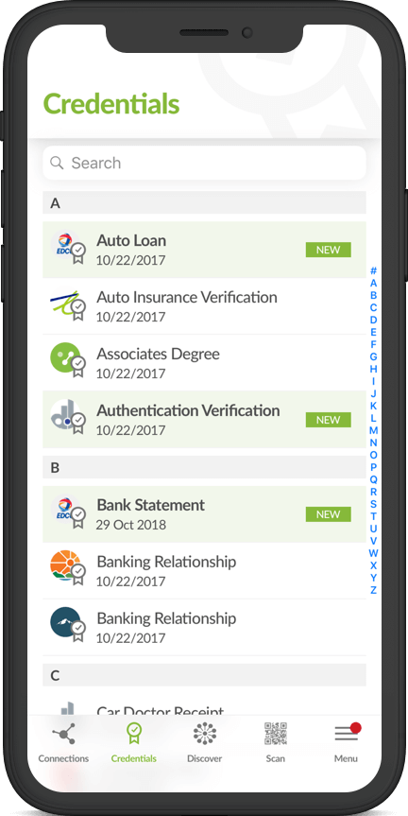
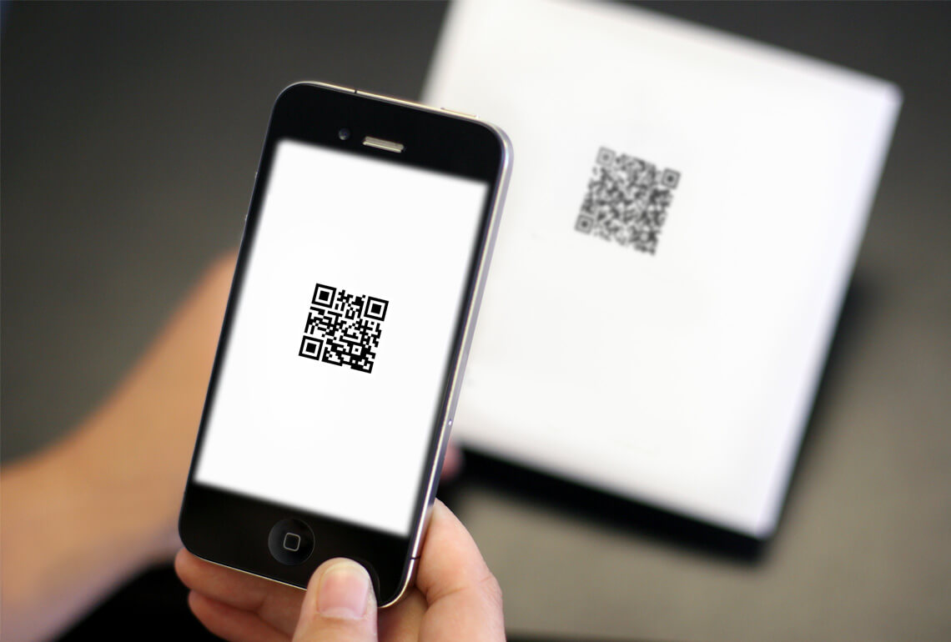
Using Verifialble credentials
THE CASE FOR SELF SOVERIGN IDENTITY FOR COVID
A Free mobile app (connect.me, trinsic.id, PocketCred) will hold a Digital Wallet with Verifiable Credentials
A medical agency such as a doctor’s office/clinic will issue a verifiable credential for a vaccine or test result
Customer/Employee stores credential in mobile app
Customer/employee present credential for verification at work/shopping/travel sites

Slide 14
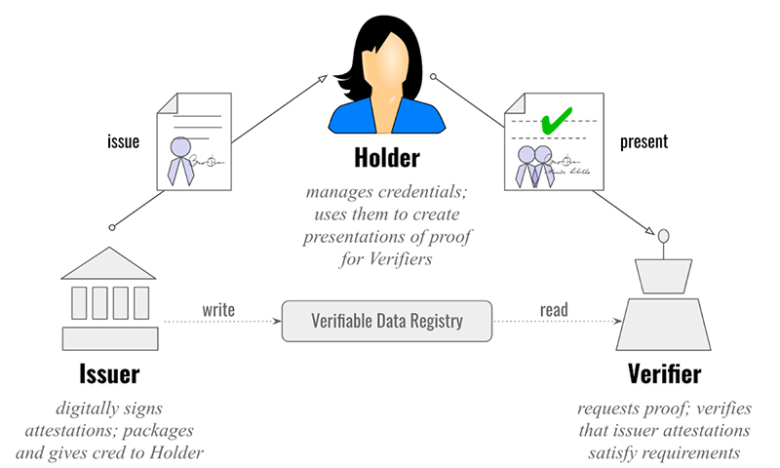
Using Verifialble credentials
THE CASE FOR SELF SOVERIGN IDENTITY FOR COVID
How it works
Source: https://www.evernym.com/blog/gentle-introduction-verifiable-credentials/

Slide 15
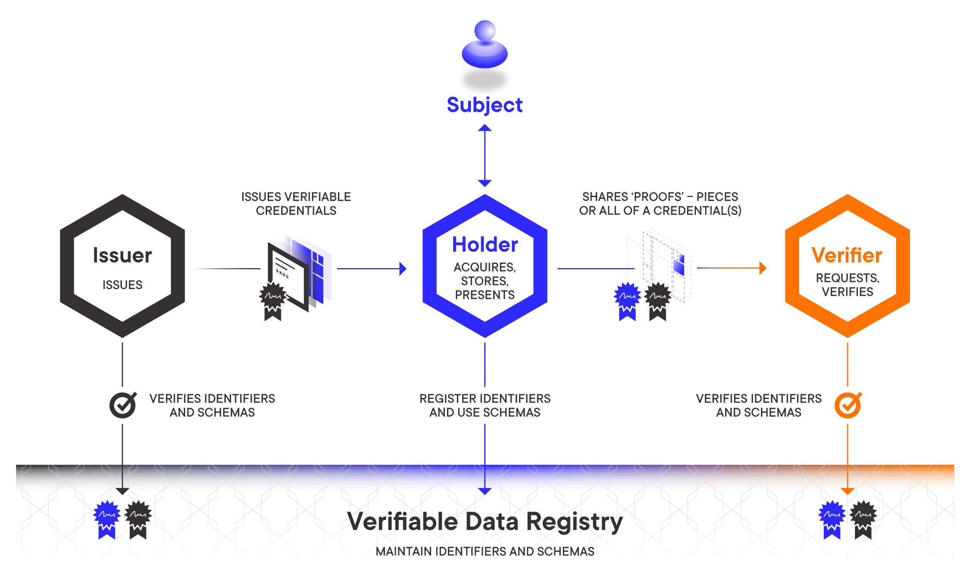
Using Verifiable credentials
THE CASE FOR SELF SOVERIGN IDENTITY FOR COVID
Quick Primer on verifiable credentials
Source: https://medium.com/mattr-global/a-solution-for-privacy-preserving-verifiable-credentials-f1650aa16093

Slide 16
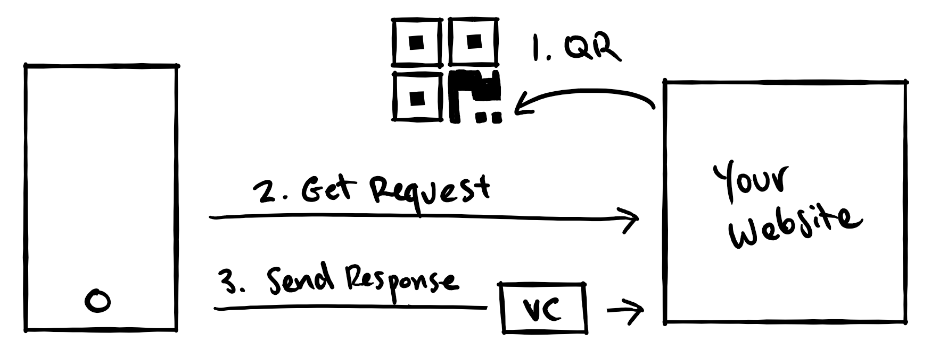
Using Verifialble credentials
THE CASE FOR SELF SOVERIGN IDENTITY FOR COVID
Quick Primer on verifiable credentials
Mobile
App
Verifier
Verifier presents a QR Code; Mobile App reads it and sends the Verifiable Credential Requested

Slide 17
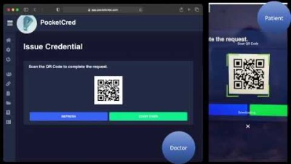
Using Verifiable credentials – How it Works
THE CASE FOR SELF SOVERIGN IDENTITY FOR COVID

Slide 18


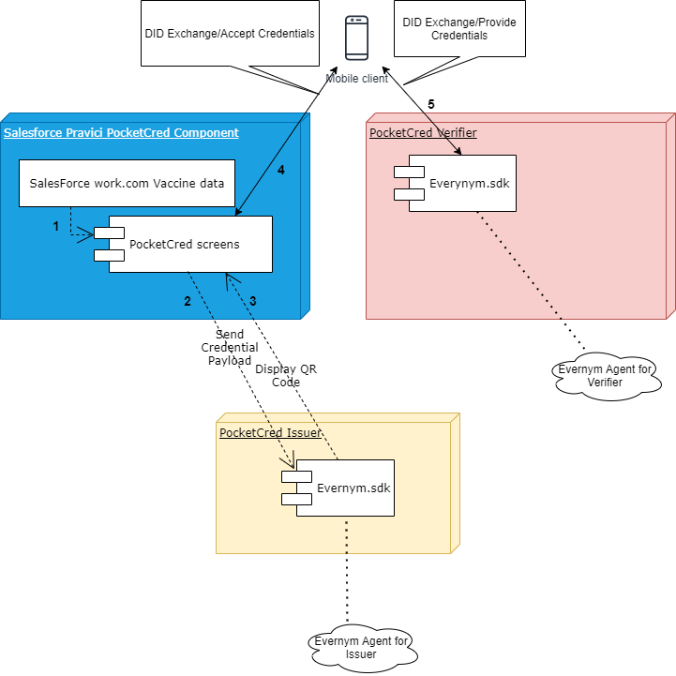
Example of Integrating Pravici PocketCred ™ with Salesforce work.com for Vaccines
Ashish

Slide 19
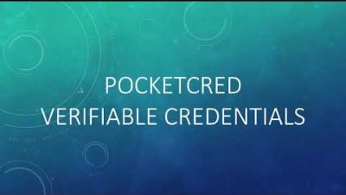
Salesforce Integration – How it Works
THE CASE FOR SELF SOVERIGN IDENTITY FOR COVID
Ashish

Slide 20
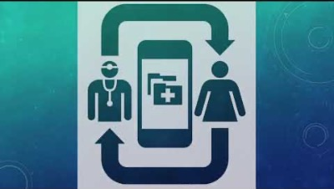
Schemas & Proof Templates
THE CASE FOR SELF SOVERIGN IDENTITY FOR COVID
Jason

Slide 21
Challenges
Issuing a credential at the time a customer receives a vaccine is not practical – Self Attestation, upload proof of vaccine; Retrieve vaccine information from a Health Portal
Retrieving Vaccine Data from State Immunization Information Systems – Multiple players, API’s at different levels of maturity
Record matching – How to match your record with State IIS records ?

Slide 22
Challenges
Standardization is still evolving, Credential issued once needs to be accepted everywhere– Good Health Pass Initiative, IATA Travel Pass, Vaccine Credentials Initiative, FHIR SMART Health Cards
Where do we discover the public Key ? – Trust Frameworks, Universal Verifier, Decentralized Key Management using Blockchains such as Sovrin/Indy
What is the Revenue Model ? – Who pays for all of this

Slide 23





ashish@pravici.com
Team
For more information or to setup a demonstration, please email us or visit our website www.pocketcred.com
mahesh@pravici.com

