Slide 1
Best Practices and Common Challenges when Upgrading to Hyperledger Fabric v2.2
KrypC Technologies

Slide 2





KrypC Team
Christopher Smith
VP – Sales
Mohit Kumar Sethi
VP - Technology
Karthik Nair
Research Engineer
Akshaya Ravi
VP - Operations
Notes:
Presenter: Chris Smith

Slide 3






A bit about us
Who we are and our journey
5+
Years
11
50+
40+
Live Application
Use Cases
Team Size
Fortune 500 Clients
Strong R&D Tradition
IP & Product Focused
Global
Presence
Notes:
Presenter: Chris Smith

Slide 4


7 Products, 1 Goal
KrypC Studio*
KrypC Workbench*
KrypC MS*
KrypC VaaS
Low-code
GUI Driven
Managed HLF Services
Verification-as-a-Service
KrypC Data Lake*
KrypC BaaS
KrypC V-Board
Coming Soon!
Analytics
Blockchain-as-a-Service
Remote Video Transaction
Making all digital information trustworthy through responsible technology will benefit society and humankind.
*Micro-services of KrypC BaaS
Notes:
Presenter: Chris Smith

Slide 5
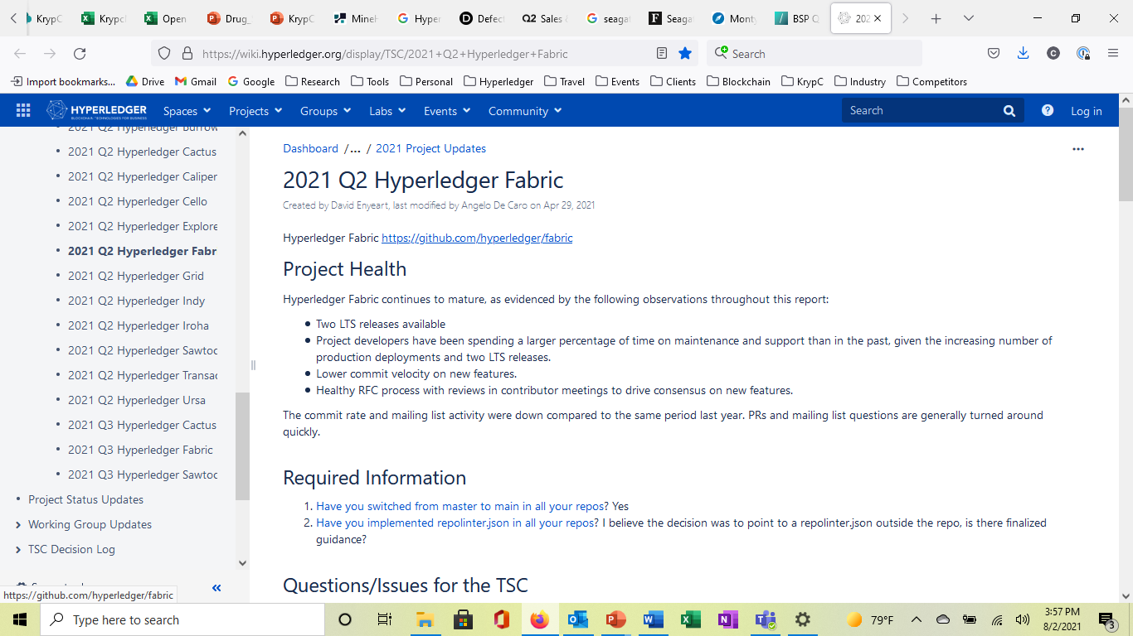
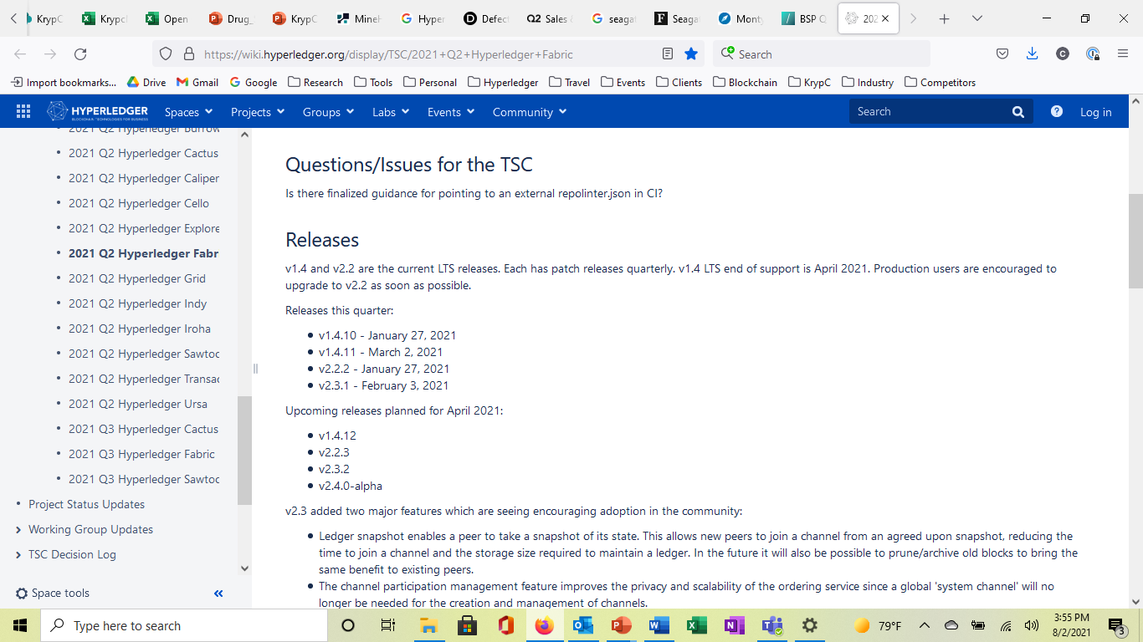
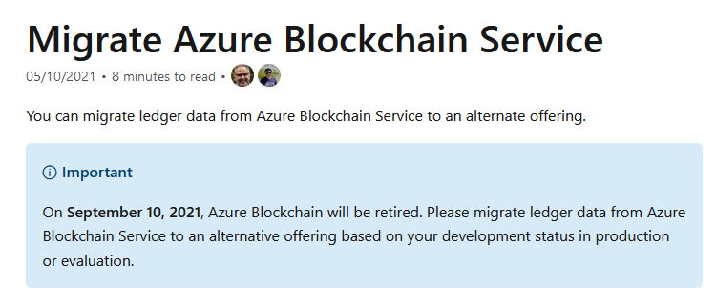
The Challenge
End-of-support Announcement for Hyperledger Fabric v1.4 (April 2021)
End-of-support Announcement for ABS (September 2021)
Notes:
Presenter: Chris Smith
Purpose:
Set the stage for the presentation
Discuss why there is a need to upgrade
What is the state of the market around upgrades (IBM, Azure deprications)
KrypC has been providing various HLF services ranging from consulting, application development, deployment, troubleshooting, managed services etc since 2016.
Given the maturity curve most of the programs in the past were not in prodcuction, so the upgrades were offline, therefore it wasn’t a business critical issue.
As many programs are now “live” the “in place” upgrade is becoming more common. In place upgrades are relatively complex given the business dependency of multiple parties in the ecosystem. We are witnessing more enterprises approaching us in recent times and each one is very unique.
in this session my colleagues will share their real-life upgrade experiences without any reference to client names respecting the confidentiality.
This session is structured to cover:
a) the unique aspects of HLF 2.X
b) many possible scenarios of deployments (cloud, Cluster, VM, etc etc) Karthik can build a table for this)
c) business and technology aspects to be considered
d) methodology with dos and don’ts

Slide 6
5 Best Practices
Upgrading to Hyperledger Fabric v2.2

Slide 7
#1: Create a plan to perform upgrade on multiple test instances
Setup test instances using existing data and run upgrades
Validate functions using external chaincode (If using Kubernetes)
Fine tune planning based on the outcome, for example:
  Sequence of operations
  Channel/Chaincode policies
Notes:
Presenter: Karthik
Purpose:
Show that we have experience with upgrades
Discuss what needs to be done for a successful upgrade
Give examples of what can typically go wrong in the process
Show how we have helped clients through this challenging process

Slide 8
#2: Evaluate end-to-end functioning before production upgrade
Check functioning of: Endorsement transactions
New life cycle process flow
Channel updates
Notes:
Presenter: Karthik
Purpose:
Show that we have experience with upgrades
Discuss what needs to be done for a successful upgrade
Give examples of what can typically go wrong in the process
Show how we have helped clients through this challenging process

Slide 9
#3: Plan backup and rollback procedures at each consortium member
Entire network needs to rollback in case of failure to upgrade by other members
Hyperledger Fabric consortium can span over multiple members spread in multiple geographies and utilizing various platforms
Notes:
Presenter: Karthik
Purpose:
Show that we have experience with upgrades
Discuss what needs to be done for a successful upgrade
Give examples of what can typically go wrong in the process
Show how we have helped clients through this challenging process

Slide 10
#4: Downtime handling
Evaluate if chaincode transactions can be disabled
Phase the peer upgrades to enable downtime query reporting (if required)
Notes:
Presenter: Karthik
Purpose:
Show that we have experience with upgrades
Discuss what needs to be done for a successful upgrade
Give examples of what can typically go wrong in the process
Show how we have helped clients through this challenging process

Slide 11
#5: Plan coordination between upgrade teams across all organizations in the channel
Each peer organization should perform the upgrade operation in tandem
Notes:
Presenter: Karthik
Purpose:
Show that we have experience with upgrades
Discuss what needs to be done for a successful upgrade
Give examples of what can typically go wrong in the process
Show how we have helped clients through this challenging process

Slide 12
5 Common Challenges
Upgrading to Hyperledger Fabric v2.2

Slide 13
5 Common Challenges
Performing consensus and version upgrades simultaneously
Not taking/validating backups of Hyperledger Fabric containers
Performing transactions on partially upgraded network
Failure to consider docker support issues on new Kubernetes version
Not observing the upgraded network for the first few days/week for inconsistencies
Notes:
Presenter: Karthik
Purpose:
Show that we have experience with upgrades
Discuss what needs to be done for a successful upgrade
Give examples of what can typically go wrong in the process
Show how we have helped clients through this challenging process

Slide 14
Resources
Upgrading to Hyperledger Fabric v2.2

Slide 15

KrypC ARM Template for Azure
Enables infrastructure provisioning on managed Kubernetes cluster on Azure via Azure Kubernetes Service
One click solution to create infrastructure and deploy Hyperledger Fabric services
Step-by-step guide to perform channel and chaincode lifecycle
Deploys Hyperledger Fabric 2.2 services
Step by step guide to set up external chaincode service
Separate peer and orderer cluster
Notes:
Presenter: Karthik
Purpose:
Show that we have experience with upgrades
Discuss what needs to be done for a successful upgrade
Give examples of what can typically go wrong in the process
Show how we have helped clients through this challenging process

Slide 16
References and Q&A
End of support for Hyperledger Fabric v1.4
  https://wiki.hyperledger.org/display/TSC/2021+Q2+Hyperledger+Fabric
KrypC ARM Template on Microsoft Marketplace
  https://azuremarketplace.microsoft.com/en-us/marketplace/apps/krypctechnologiespvtltd.hlfapp?tab=Overview
End of support notice for Azure Blockchain Services
  Click here
Need Help?
  Christopher Smith - (713) 927-4073
  Chris@krypc.com

