Slide 1
GSMA-DLT Shared Vision
Monique J. Morrow, Syniverse
Shamit Bhat, GSMA
Ver 1.9
Restricted - Confidential Information
© GSM Association 2020
All GSMA meetings are conducted in full compliance with the GSMA’s anti-trust compliance policy

Slide 2
Shared Industry Vision - key attributes
GSMA shared industry vision for DLT evolves around the following attributes:
DLT cannot be taken as a silo’d business but involves other business technology enablers.
We will be 80% business and 20% technology focused.
The ecosystem is multi-stakeholder - includes Opcos, Wholesale Carriers, Banks, Mobile players/ Enterprise and Policy makers.
We will show demonstrable proof points to the evolving opportunities.

Slide 3







Blockchain - How big is the opportunity for Telcos
An incorruptible and immutable decentralised digital ledger of transactions enabling asset value storage and exchange, via business rules based autonomous transaction processing.
Payments
Wholesale Settlement
Identity & Access Mgmt
Supply Chain
Blockchain as a Service (BaaS)
Fraud Mgmt
Decentralised
Ownership
Traceability
Blockchain
Transparency
Telcos Blockchain Revenue estimated to be $1.8b of $19.9b by 2024
Trust
Smart Contracts
Notes:
Telcos Blockchain Revenue estimated to be $1.8b¹ of $19.9b² by 2024
Payments and Settlement based OSS/ BSS implementations – USD multi billion
Global Identity and Access Management – $11.46b by 2026³
Supply Chain – $3.3b by 2023⁴
Blockchain as a Service – $15.4b by 2023⁵.
Fraud – $28.3b lost in 2019⁶
Sources: 1 Research & Market Telco DLT 2 Research & Market Global DLT 3 Allied Market Research Identity
4 Markets & Markets Supply Chain 5 Markets and Markets BaaS 6 Communications Fraud Control Association

Slide 4
Contextualizing the use case opportunity
Greenfield
Personal Identity
Telco coin
Device Listing
Global Identity
Bandwidth on Demand
Quantum Secure DLT
Edge Settlement
Network Info Sharing
Operator specific
Collaborative
Roaming Settlement
Fraud Litigation
Wifi Roaming Settlement
Interconnect Settlement
Fraud Management
International Voice Settlement
IPX Ops sharing
Device Identity
Cross border payments
Legacy
Fraud Intel Sharing

Slide 5
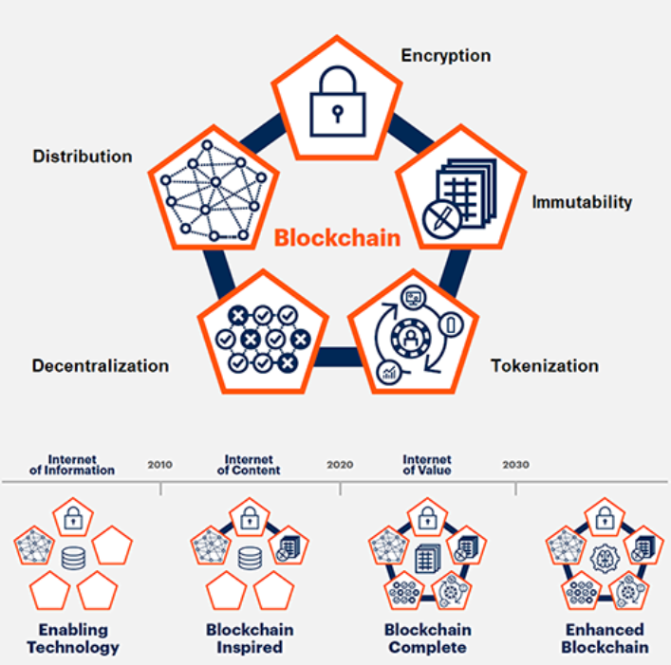

















Gartner’s 4 phase blockchain spectrum vs GSMA focus areas
Wholesale Settlement
Fraud Management
Payments
Identity
International Roaming
Fraud Mitigation
Cross border
Personal
International Voice
Fraud Litigation
Telco coin
Supply Chain
Wifi Roaming
Crypto Wallets
Device Identity
Bandwidth on Demand
National Roaming
Interconnect
Cross Domain Integration
Edge Computing
Mechanized Learning
AI
Quantum Computing
Future Networks
Notes:
Source: https://www.ledgerinsights.com/gartners-four-phase-blockchain-spectrum/
Blockchain-enabling: the technologies that formed the foundation; cryptography and peer-to-peer networks, for example. This phase ran until around 2012.
Blockchain-inspired: the current phase, where pilots and proofs of concepts (PoCs) are being explored and sometimes deployed.
Blockchain-complete: the next phase, not slated to start until around 2023. Then, all five elements will be integrated into enterprise solutions.
Enhanced blockchain: finally, after 2025, the internet of things (IoT) and self-sovereign identity (SSI) will converge with blockchain solutions. This will allow automation and transactions on a vast scale.

Slide 6
Collaborative Use Case - Concept to Delivery
Prioritise Use Case within Focus Area
Prepare Concept
Trial Concept (POC and/or MVP)
Get GSMA Board Support
Create MVP with interested operators/ vendors
Standardize
Commercial Launch
Notes:
It is envisioned that the IG DLT effort will:-
identify collaborative operator use cases
develop/ standardize common technology/layers/etc.
Split effort into multiple workstreams
workstream to develop commercial/ legal tenants of the network
Worstream to develop/ standardize common technology/ layers etc.
Use case specific work streams to together concepts, trial concepts and move towards commercialization where applicable

Slide 7
Example: Wholesale Settlements –
Unlocking a multi-billion dollar opportunity
Adoption
Settlement Costs
Automation to save monthly and annual settlement costs
Fraud Prevention
Share operational data faster to reduce or eliminate fraud
Contracts Management
Enable management of dynamic contracts and SLAs
Disputes
Shared Smart Contract logic to eliminate process discrepancies
Payments
Payments integration to settlement use cases
Cross border payment support
Digital currency with telco exchange
Identity
Personal identity support
Extend to device identity and tracking
Extend to device life cycle management for supply chain
Revolution
Opportunities
Evolution
Deployment
In millions
Industry $ Value Add
In billions

Slide 8








Example: Blockchain for Wholesale Roaming initiative
BWR participants
BCETF#1 April 2017, Bangalore, India - Blockchain raised as an alternative exchange mechanism and noted as an exploratory topic
IDS#85 May 2018, London, UK
IDS conducted its first workshop on blockchain for wholesale roaming and requested operators to conduct POCs
IDS#87 May 2019, London, UK
Several successful POCs reported and presented to IDS
GSMA Board June 2019, Hong Kong
Blockchain for roaming discussed as a GSMA board breakout session and GSMA asked to bring POC efforts together
BWR#1 September 2019, London, UK BWR group activities kicked off with 8 participating group companies
Above 60 BWR meetings since.. MVP 1 deployment by 31st March 2021

Slide 9
Example: Blockchain for Wholesale Roaming initiative
Blockchain for Wholesale Roaming (BWR) is a GSMA initiative to evaluate the benefits of blockchain technology to further realise efficiency gains for wholesale roaming clearing & settlement business.
Participants
by APR’21
Faster Settlement
Reduced Fraud
Cost Savings
Greater Automation
Fewer Disputes
Current MVP Focus
Annual Discounting settlement
  Hyperledger Fabric
BWR Objectives
MAY’21 onwards
Future MVP(s) Focus
TAP and/or BCE + Inter-ledger Interoperability
  Hyperledger, Ethereum and Corda
TAP and/or BCE + Inter-network Interoperability
BWR Group Workstreams
Technical
Commercial
Governance
How to participate?
All GSMA members are welcome to join
  Bring own skills, resources & funding
  Hands on development & specifications
  Reference Industry Implementation
  Open sourcing model
Learn More

Slide 10
Success Factors/ Implementation Strategy
Success Factor | Implementation Strategy
Interoperability | Keep a track of solutions in the market and adapt as standard (ex: polkadot, cosmos, IBM relay network)
Scalability | Start small and scale gradually, work with broader DLT ecosystem to identify solutions
Sustainability | Ensure the solutions offered have sustainable benefits over the long run
Security and Privacy | Operators must map DLT security/ privacy features with their current/ future needs
Technology Maturity | Work with DLT experts within and outside industry to help mature DLT as per telco needs
Regulations | As most regulations are use case and region specific, manage on case to case basis
Capacity building | Promote creation of centres of excellence within the GSMA and within each OpCos
Legacy vs Disruption | Identify use case specific value preposition for making a transition to DLT
Collaboration | Encourage collaboration between GSMA and wider DLT ecosystem
Governance | Framework to be agreed specific to the network purpose and to be defined based on use cases specific requirements.
Commercial | The commercial aspects require due understanding of operations, funding model used and ROI
Legal | Based on the governance and commercial requirements legal framework will to facilitate frictionless operating model.

Slide 11
Blockchain Ecosystem Formation
Build an Ecosystem - support multiple players/ use cases
Orchestrate a Shared Network–support multiple services on shared governance infrastructure
Provide Access to Strategic Stakeholders – MNOs| OEMs| Partners| Suppliers| Taxman| Legal| Regulatory

Slide 12
Blockchain Shared Network
Identity
Fraud Management
DLT Network
Services
partners
suppliers
N/W Management
clients
consumers
regulators
Tech Infra
Clearing & Settlement
Internet of Things

Slide 13
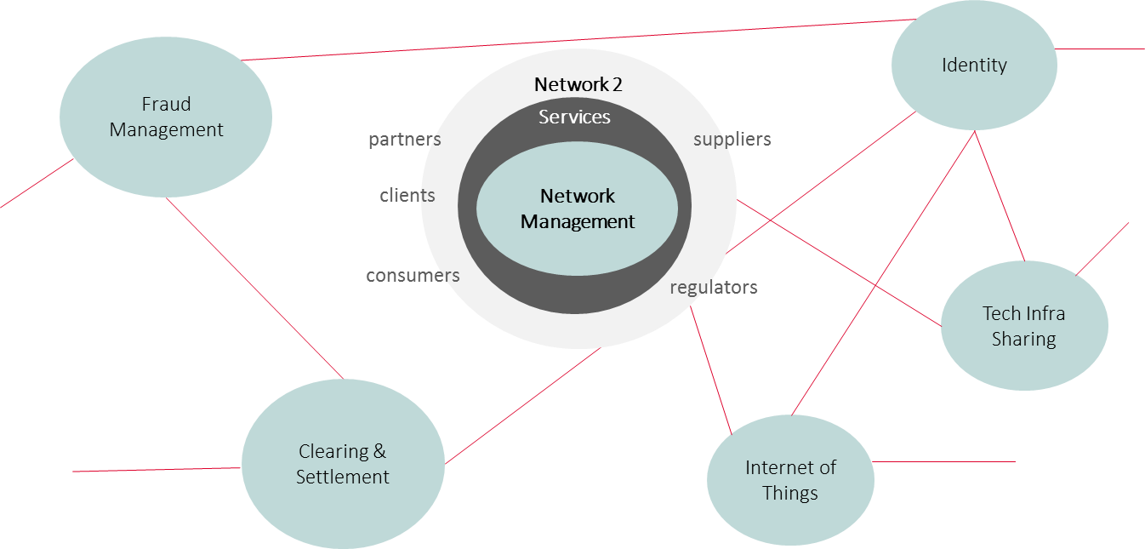

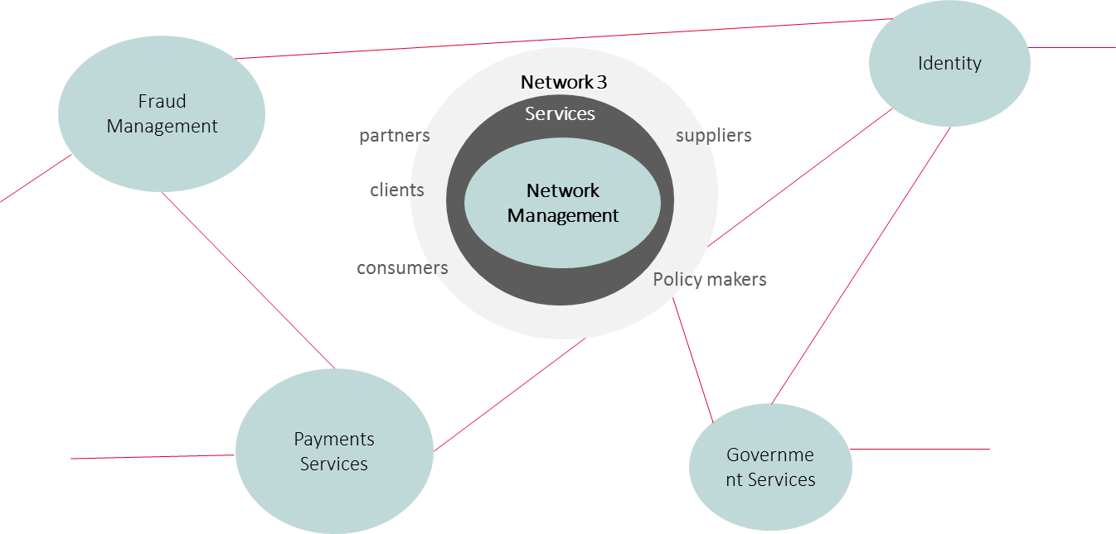
Blockchain Network of Networks
N1 N2 interface
N1 N3 interface
N2 N3 interface

Slide 14
Blockchain 3.0 Reference Architecture
Open Source Elements
The GSMA architecture is highly modular and largely open sourced to foster transparency, trust and network affect, enabling a thriving shared network economy.

Slide 15
How Do We Measure Success Together?
KPI | Strategy
PoCs-MVP to Business | Measure transition from PoCs and/or MVPs to actual business for each use case
Standardization | Assess industry gaps in Blockchain-DLT, position GSMA as a key player for gap closure
Adoption Blockchain 3.0 Reference Architecture | Measure industry adoption of GSMA Blockchain 3.0 Reference Architecture that results in sustainable business
Policy Partner | Position GSMA-DLT as regulator-policy partner globally as part of ecosystem extension
Capacity Building | Develop and execute webinars highlighting opportunities, lessons learned and business

Slide 16







GSMA Role(s): Eco-system creation & Management
Mobile Operators & eco-system partners To build solutions on top of It
Potential GSMA Roles
Network Backbone
Network Backbone Provider
MNO
Network Governance Facilitator
Opco
Group
MNO
Opco
Network Administrator
MNO
Participant Manager
Third
Party
MNO
GSMA to Administer Governance Rules
Service(s) Provider
GSMA To Recruit Ecosystem

Slide 17
DLT Telco Eco-system Stakeholders and Roles
DLT telco eco-system is dynamic and contextual.
Being agile to pivots in the market amplifies why the ecosystem is contextual.
Stakeholder | Type | Main Role
Standardisation bodies | Influencer | Governance
Blockchain Consortia | Influencer | Governance
Operators | Beneficiary | Central Player
MVNOs | Beneficiary | Central Player
5G Private Networks | Beneficiary | Active Player
Blockchain Experts | Solution Provider | Active Player
Eco-system partners | Solution Provider | Active Player
GSMA Working Groups | Influencer | Active Player

Slide 18


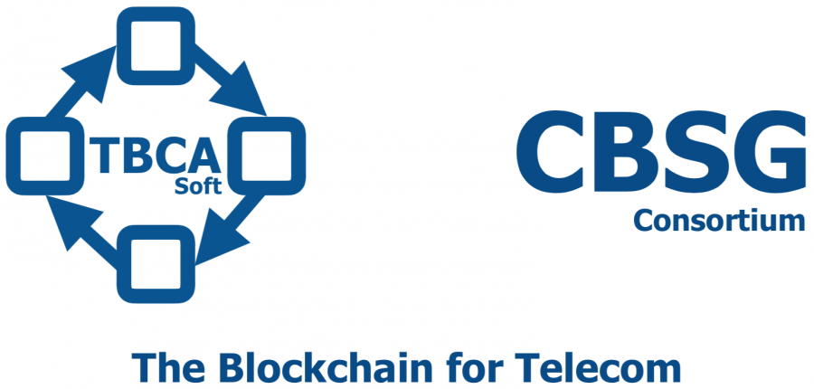

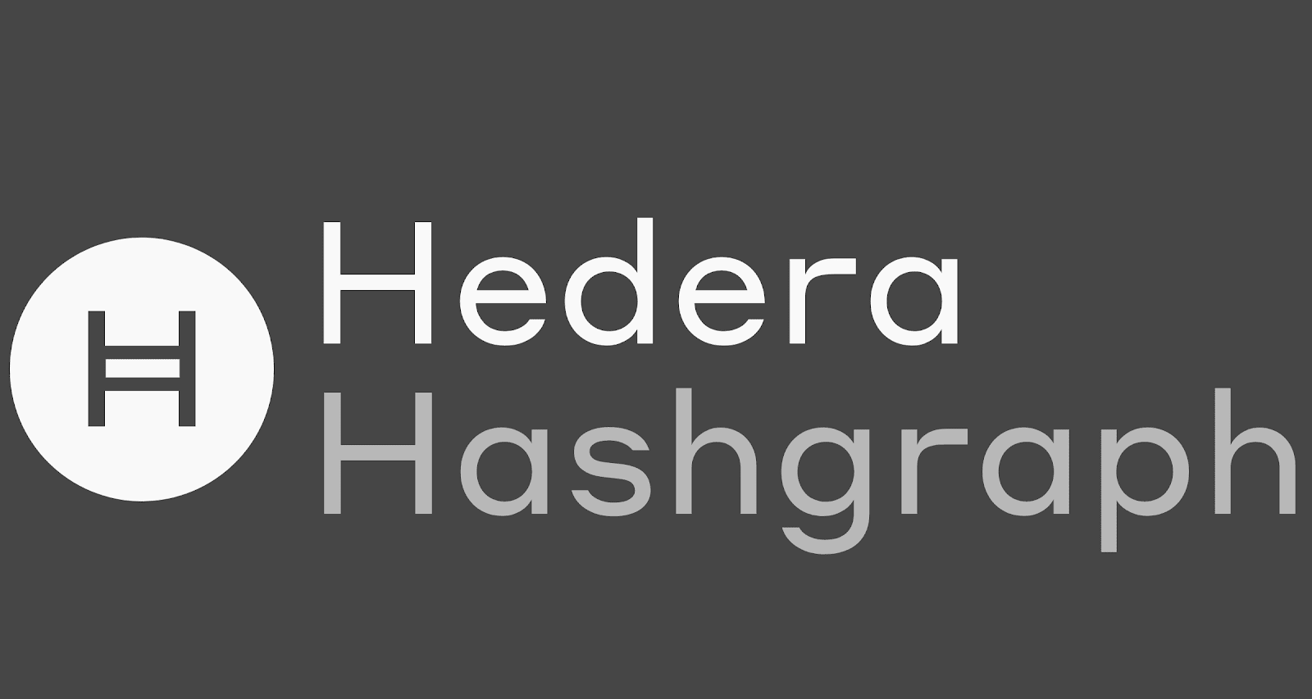




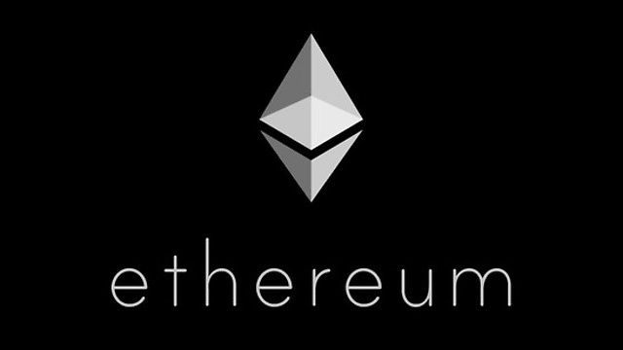



Current Snapshot: GSMA’s DLT Eco-system Players
High
Influential Observers
Key Participants
Keep Satisfied
Engage Closely
Working Groups
Projects
Board/ TG
MNO
IG, BWR, Identity
Opco
Group
MNO
Third
Party
Influence
Passive Observers
Active Participants
Monitor & Transition
Keep Informed
MVNOs
Private
Networks
Third
Party
Low
Low
Interest In DLT
High

Slide 19
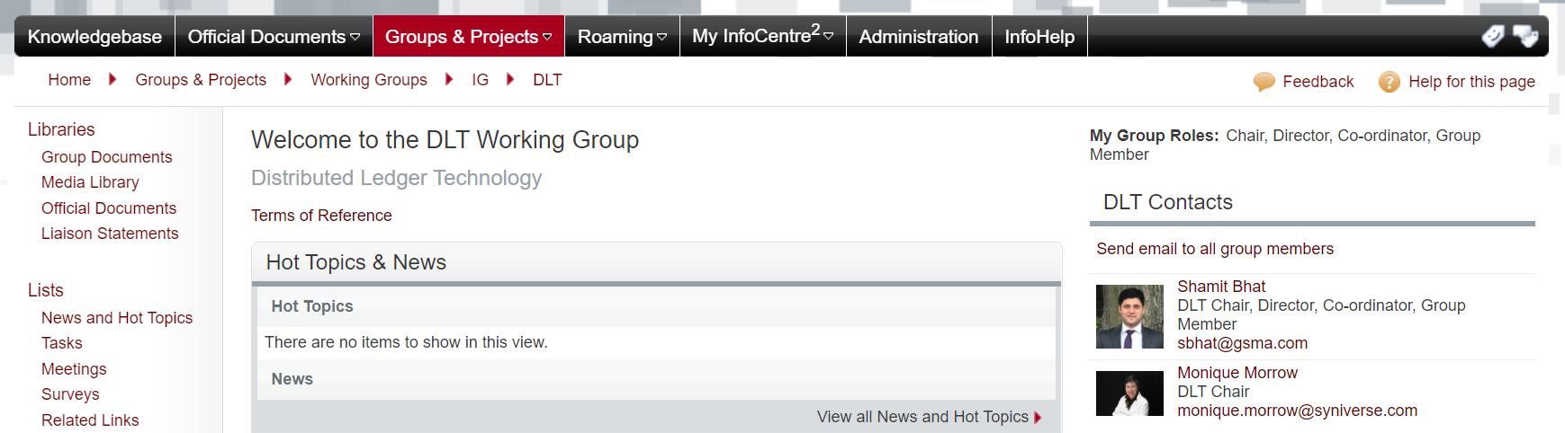
Shared Vision Execution
In light of operator demand and in acknowledgment of permanence of blockchain activities
  GSMA has agreed to create a dedicated DLT group under IG
  The group will be responsible for shepherding the shared vision execution
  ToRs and Group activities to be agreed
  Join the group on IC2 to participate

Slide 20

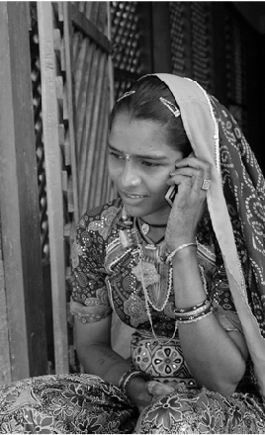




Thank you

