Slide 1
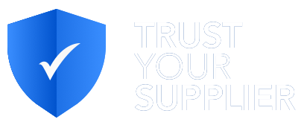


Trusted Source of Supplier Information and Digital Identity

Slide 2



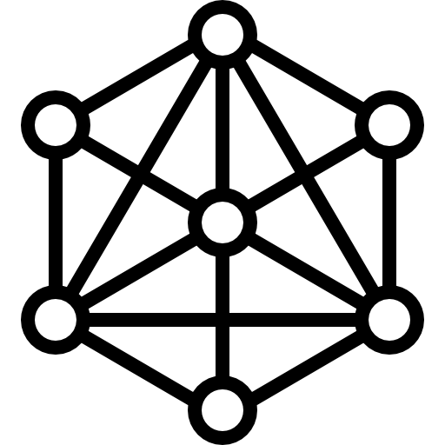






Introducing CHAINYARD™
CLIENTS
IBM – Lenovo - Deloitte . MetLife - RTI – PRGX - LedgerFunding
SERVICES
65+
Technical and Business Consulting, Engineering and Operations
Blockchain Consultants, Architects and Developers
DOMAINS
24+
Supply Chain, Transportation, Manufacturing, Healthcare, Financial, Retail, Agriculture, Real Estate
Solutions,
PoCs to Production
Including
TYS
DIVERSITY
MEMBER
TAPFIN 2017,
MetLife 2016-2017
Member and Contributor to
Hyperledger Fabric platform, BiTA, SCLA
ACCELERATORS
LOCATIONS:
US, INDIA
Frameworks, tools and utilities
for faster solution development

Slide 3


About CHAINYARD™
WE TURN BLOCKCHAIN INTO BUSINESS RESULTS.
Deep expertise in Enterprise Blockchain adoption & solution implementation
Key contributor with IBM to Hyperledger Fabric platform
Pre-built components, frameworks and tooling to accelerate project delivery and improve ROIs
Production solutions in multiple domains – Supply Chain, Manufacturing, Transportation, Logistics, Financial Services, Asset Management, and Procurement
Expertise in Consortium Building and Governance
Members of The Linux Foundation, Hyperledger, Blockchain in Transport Alliance (BiTA) and Supply Chain Leaders in Action (SCLA)
24+ Projects
4 in Production
2+ in Pilot Phase
3+ Projects > 18 Months
Morrisville, NC, USA Based

Slide 4



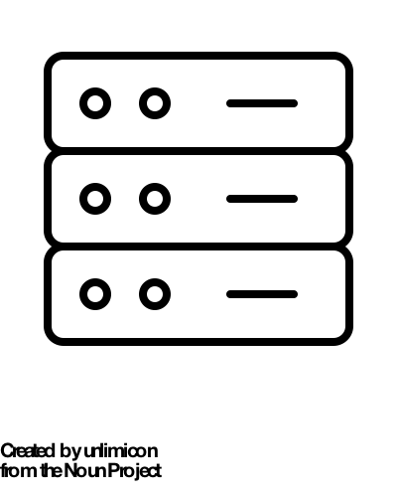
We Turn Blockchain into Business Results
Services for Enterprise Blockchain Adoption & Solution Implementation
CONSULTING
ENGINEERING
OPERATIONS
CONSORTIUM
Define new business processes and models with analysis framework
Develop production-ready applications with best-fit technologies & accelerators
Maintain decentralized network & systems with optimized processes & best practices
Define governance model and build consortium with frameworks
Analyze business problems
Identify relevant use cases
Assess blockchain applicability
Establish technical feasibility
Define MVP & roadmap
Develop Proofs-of-Concepts
Finalize the technology stack
Create relevant architectures
Implement iteratively
Test, validate & demonstrate
Establish the network
Permission the network
Manage network operations
Maintain the network
Develop the consortium
Develop Business and technology considerations
Establish governance model

Slide 5
AGENDA
INDUSTRY PROBLEM
TYS SOLUTION
OUTCOMES & VALUE PROPOSITION
GOVERNANCE
ROADMAP AND NEXT STEPS

Slide 6

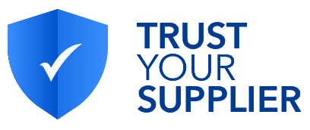

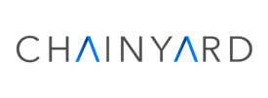

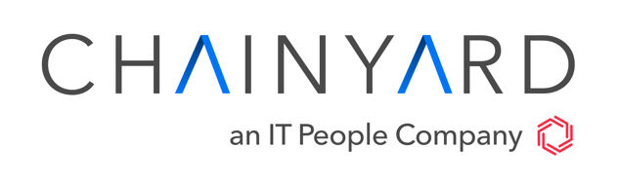
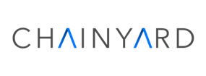
Uniting our
Source To Pay Expertise and
Scalable Blockchain Platform to Reimagine Procurement
We Turn
Blockchain into
Business Results.
Procurement Expertise
Open, Secure, & Scalable Blockchain Platform
Industry Leading Enterprise Blockchain Network
World-Class Blockchain Solution Providers
Production Solutions in Financial Services and Supply Chain
Over 100 Blockchain Specialists
Services ✦ Solutions ✦ Ecosystem ✦
Platforms ✦ Hyperledger
Consulting ✦ Engineering ✦ Operations ✦ Consortium Building ✦ Accelerators

Slide 7
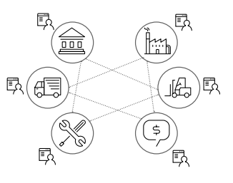
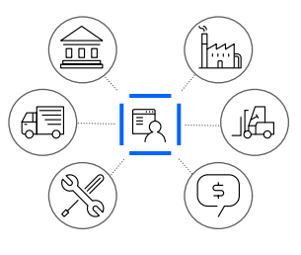
TRUST YOUR SUPPLIER – WHY BLOCKCHAIN
Conventional Systems are open to error, fraud and inefficiency
  In conventional systems each participant has his own, separate database, or ledger — increasing the possibility of human error or fraud
  Shared databases cannot prevent malicious activity. Hacked entities can corrupt or destroy data in the shared database, making it invalid for everyone involved.
  Reliance on intermediaries for validation creates inefficiencies
  Often laden with manual processes, resulting in frequent delays and inefficiencies
Blockchain is designed for trust and secure trading
  Single, shared, tamper-evident ledger — once recorded, transactions cannot be altered
  Provides levels of error checking and transaction validity not obtainable in regular shared databases.
  Data is guaranteed to be valid and reconciled against the data held by the others participating on the Blockchain.
  Immutably records all details of a transaction end-to-end, reducing vulnerabilities.
Blockchain Provides a Trusted, Common, Single Version of the Truth
Copyright © 2020 CHAINYARD™️

Slide 8







OBJECTIVE
Create a
Trusted Source of Supplier Information and Digital Identity
Reduce Cost
that simplifies and accelerates
Shorten Cycle Time
Mitigate Risk
Supplier Onboarding and Lifecycle Management
Create Trust
Notes:
Enter info-pic
Multiple people-comp

Slide 9







SUPPLIER MANAGEMENT CHALLENGES
QUALIFICATION
VALIDATION
ON-BOARDING
LIFECYCLE
Difficult to ensure supplier identity
Hard to discover quality suppliers
Cumbersome process
Reliant on multiple 3rd party verifiers
Costly, manual web checks
Limited access to trusted supplier certifications and history
Limited integration of SIM providers to P2P/ERP systems
Absence of real-time supplier information updates
Need for ongoing, multi-source intelligence to assess third-party risk
SLOW AND INEFFICIENT PROCESS
DYNAMIC REGULATORY REQUIREMENTS
TECHNOLOGY GAP
Time to first transaction is often
30+ days
Suppliers provide nearly same data to every buyer
Buyers independently manage data which is often stale
Need for increased supply chain agility
Increasing compliance requirements, audits, and penalties
Existing technology limits ability to receive real time updates
Siloed systems don’t work across enterprises
9

Slide 10


OUTCOMES: BUYERS
~90%
Real-time updates
to supplier information
Provides immediate access, real time to supplier data at a fraction of cost
Greatly simplifies current technology and process
Minimizes supplier risk and ensures compliance
Accessible, permanent record of supplier claims to improve compliance and speed audits
Real-time updates
70-90%
Reduction in cycle time to onboard new supplier
Increased
Trust
Reduced cycle time
Reduced Cost
50+%
Reduction in cost to onboard new supplier

Slide 11

OUTCOMES: SUPPLIERS
~90%
Elimination of repetition and redundancy
Elimination of repetition
Eliminates redundant submission of same information multiple times to different buyers
Reduced time to first transaction
Improved discovery for buyers on the network
70-90%
Reduction in cycle time to onboard as a new supplier
Increased
Trust
Reduced cycle time
Reduced Cost
50+%
Reduction in administration cost maintaining status & collateral across buyers

Slide 12







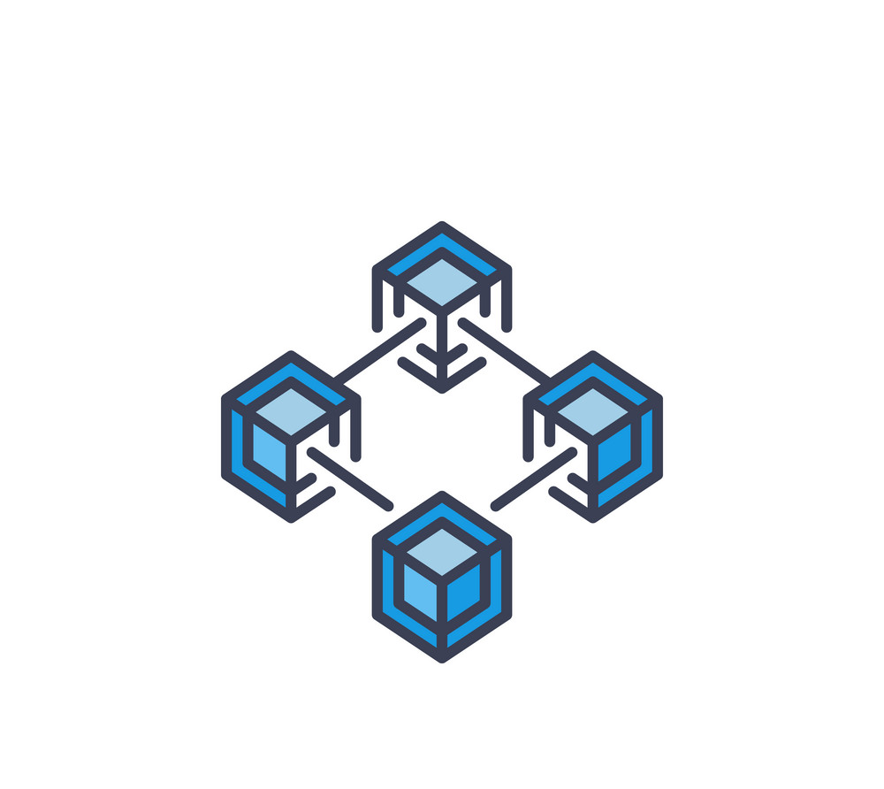




TRUST YOUR SUPPLIER
I only have to provide my company info once
Supplier
I have instant access to 360 degree pre-verified onboarding supplier info
BLOCKCHAIN-BASED SUPPLIER INFORMATION MANAGEMENT
A Trusted Source of Supplier Information and Digital Identity that simplifies and accelerates Supplier Onboarding and Lifecycle Management
I can build new apps using the platform’s data and services
Buyer/
Procurement
3rd Party Developer
Business Network Provider
Verifier
Supplier Information Management Blockchain Network
I can provide verification as a service
Up-to-date client data allows me to automate onboarding & maintenance plus offer new services
Auditor
Certificate Issuer
Create a source of supplier information and digital identity using BLOCKCHAIN
Suppliers provide Buyers immediate access to their data (regulatory, compliance, legal etc.)
Simplify and accelerate Supplier Qualification, Onboarding & Lifecycle Management
I can easily access info for all auditing purposes
I can verify the originality of the certificates easily and build trust
Decentralized information sources provide reliable data directly onto the blockchain – validated by 3rd parties.
~90%
Real-time updates
to supplier information
70-90%
Reduction in cycle time to onboard new supplier
50+%
Reduction in cost to onboard new supplier

Slide 13


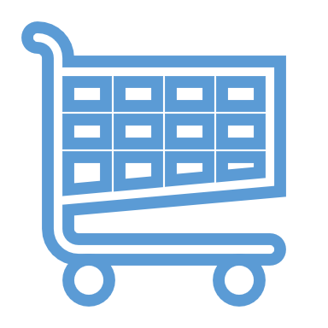



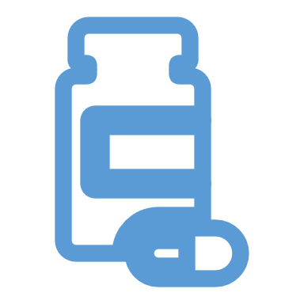





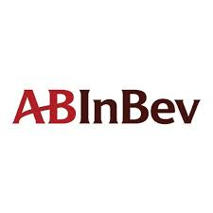












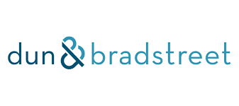
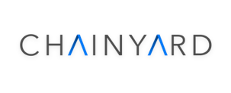


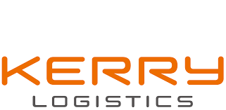






WHO IS TRUST YOUR SUPPLIER?
Governance Board
Aerospace
Automotive
Consumer
Logistics
Electronics
Tech
Industrial
Pharma
Telecom
Financial
Mining,Oil,Gas
Ecosystem
TBD
Network Operator
Ecosystem Partners -Validators
Ecosystem Partners - Business Networks
Founding Buyers

Slide 14







TRUST YOUR SUPPLIER – VALUE PROPOSITION
SUPPLIERS
Easy discovery to network Buyers
Reduced cycle time, cost, and effort to onboard
Provide real time information updates to buyers
BUSINESS NETWORKS & 3RD PARTY DEVELOPERS
Potential for integration via APIs
New & consolidated distribution channel
Provides differentiated add-on data & insight services
Enhanced performance of existing solutions
Referral share potential
BUYERS
Faster access to validated supplier information
Realtime supplier information
Cost effective supplier onboarding process
Reduced risk and enhanced regulatory compliance
OWNER/OPERATOR
Establish and operate network (performance, security)
Oversee evolution of network
Provide Governance Council leadership
Oversee Portfolio, Investment, & Financial Performance
AUDIT / COMPLIANCE
Easy, trusted access to supplier compliance data
Substantiates credibility & compliance of network members
Provide data and reporting on suppliers
Enforcement of legal and regulatory framework
TRUSTED ANCHORS
Governance Council membership
Guide network evolution and product roadmap
Seed the network with supplier base
Provide Industry SME and Thought Leadership
Recruit other Buyers to join network
VERIFIERS & CERTIFICATE ISSUERS
New, consolidated distribution channel
Simplified transaction base (single invoice/collection)
Share of new revenue / payment for service
Provide validated information to network

Slide 15




SUPPLIER DATA HIERARCHY
Common, standardized supplier data content and questionnaire detail is key to the network’s value proposition
<5%
Supplier information specific to the Buyer
Custom questionnaires provided by Buyer
Information revealed only to Buyer; not available to others on network
BUYER
10-15%
Supplier information specific to the location which business is conducted
Standard questionnaires and content based on geographic presence
Information revealed only to Buyers operating in those regions
GEOGRAPHIC
20-25%
Supplier information specific to the industry which business operates
Standard questionnaires and content based on industry
Information revealed only to Buyers operating in those industries
INDUSTRY
>50%
Supplier information specific to the location which business is conducted
Standard questionnaires and content based on geographic presence
Information revealed only to Buyers operating in those regions
COMMON
FOUNDATION

Slide 16
TRUST YOUR SUPPLIER BLOCKCHAIN – FUTURE STATE
I only have to provide my company info once
TYS Blockchain is a trusted source of digital identity for suppliers
With Blockchain, suppliers can provide permissioned access to their regulatory, compliance, environmental, legal , etc information to Buyer organization
Supplier
I have instant access to 360 degree pre-verified onboarding supplier info
I can build new apps using the platform’s data and services
Buyer/
Procurement
3rd Party Developer
Business Network Provider
Verifier
Decentralized Original Information Sources provide data directly onto the blockchain
Verifiers such as D&B, T&R (financials, credit, adverse media,etc)
Certificate Issuers such as ISO, diversity agencies (quality, insurance, compliance, etc)
Auditors (factory, financial, quality, etc)
Government (OFAC, business registration, etc)
Supplier Information Management Blockchain Network
I can provide verification as a service
Up-to-date client data allows me to automate onboarding & maintenance plus offer new services
Auditor
Certificate Issuer
I can easily access info for all auditing purposes
I can verify the originality of the certificates easily and build trust

Slide 17
















TYS Network Status Chart
11
Governance Founding Members
11 out of 14 Governance Founding members spots filled
4 Founding members spots filled
Supplier on-boarding started in USA
4
Founding members
100+
Suppliers Invited
4
Verifiers / Raters
4
Business Networks
17
Copyright © 2020 CHAINYARD™️

