Slide 1

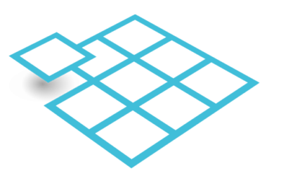

Connecting FIX to FinP2P
to enable interoperability between trading platforms and tokenized assets
STRICTLY PRIVATE AND CONFIDENTIAL, NOT FOR ONWARD DISTRIBUTION

Slide 2
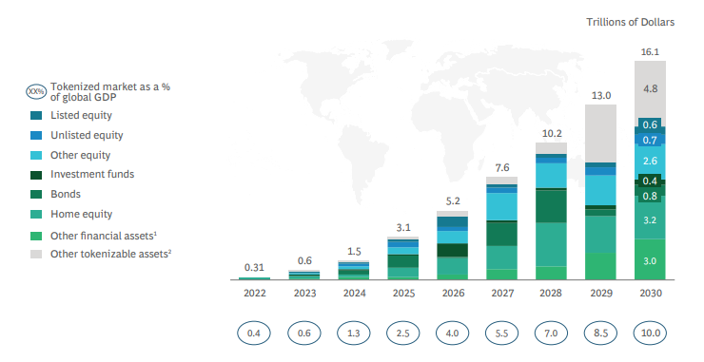
Financial institutions already invested tens of millions each*
in tokenization solutions - to serve trillion-dollar markets
*JP Morgan, Goldman Sachs, Citi, DTCC, UBS, BNP, HSBC, Blackrock, BNY, LSEG, NYSE, Deutsche Börse, Euroclear…
Tokenization flattens pre-trade, trade and post-trade into a fast, efficient, reliable
digital process.
COST SAVING
Operations
Technology
Capital efficiency
REVENUE GENERATION
Instant collateral mobility
Access to assets <> Capital formation
Secondary trading, collateral and lending
Asset services, payments and transfers
Market data and new AI services
Source: Boston Consulting Group

Slide 3
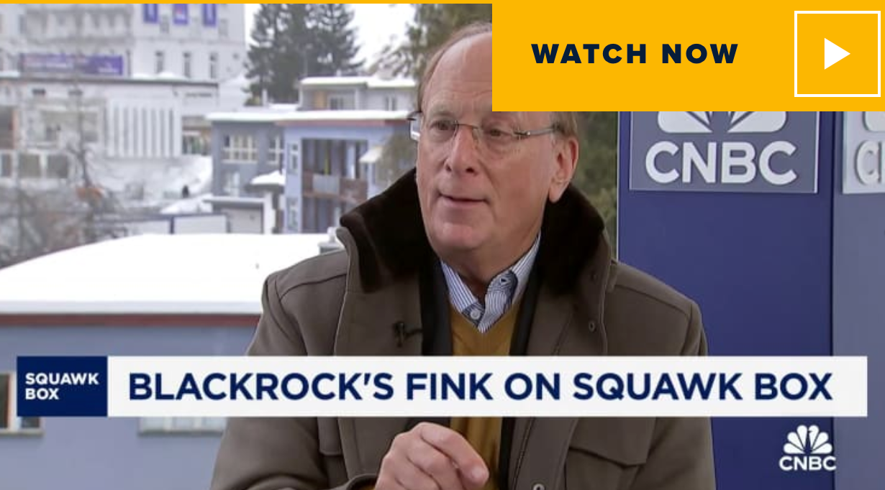
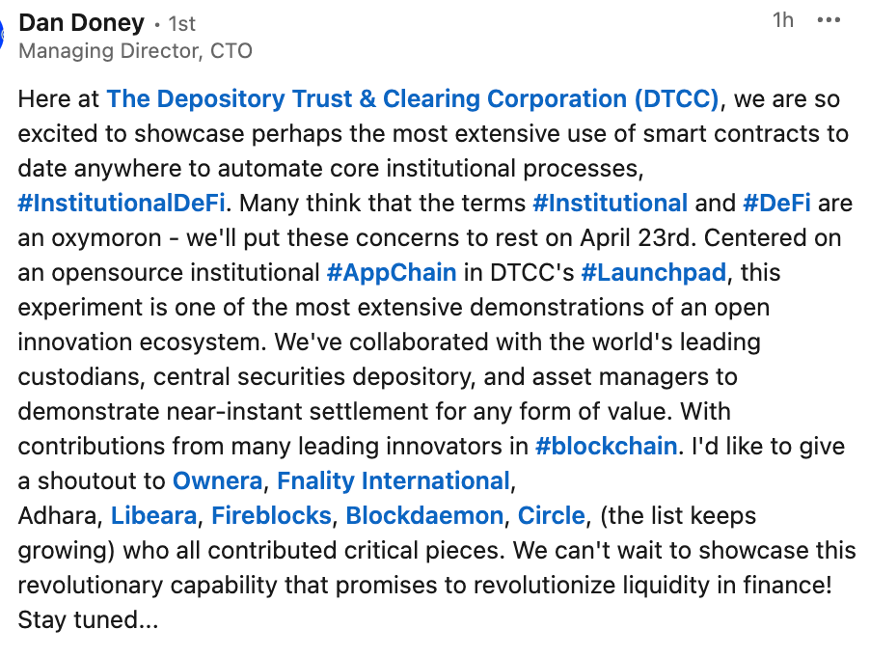
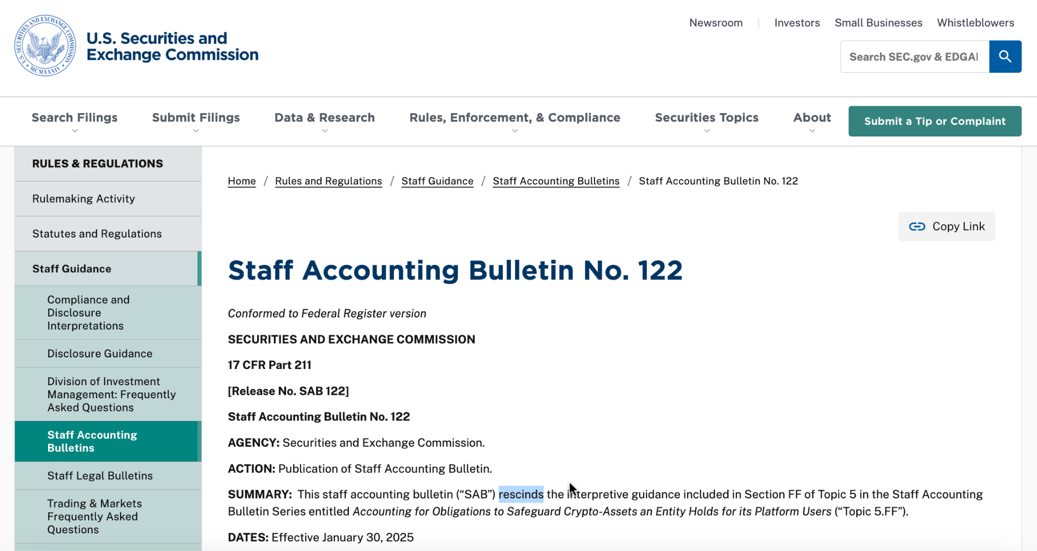
TOKENIZATION - WHY NOW ?
The new U.S. administration and regulators are finally enabling tokenized assets through immediate and impactful actions
U.S. regulators, including the SEC and OCC opened the doors for financial institutions to hold, manage and trade tokenized assets and cash.
A wave of tokenized asset and digital cash offerings is underway, growing rapidly.
We are working with DTCC on a project targeted at making all assets, including all bonds and stocks available in tokenized form for collateral mobility.
BlackRock CEO, Larry Fink called for the SEC to rapidly approve the tokenization of all bonds and stocks

Slide 4

What is FinP2P?
TOKENIZATION - FINP2P
CRYPTO
Connecting Supply <> Demand <> Services <> Data
Moving assets and data between blockchains
Custodians
Investor
Platforms
Collateral
& Lending
Router
Router
Router
Blockchain X
Blockchain
Y
FinP2P Open Protocol
FinP2P Open Protocol
Intermediary
Networks
Router
Router
Router
Payment
Tokenization
Market
Infra
Public Blockchains
Private Blockchains

Slide 5

The FIX / FinP2P integration will make it easy for the buy-side to connect
Buy-side wealth and asset managers, hedge funds and others will be able to connect their existing FIX gateways to a FinP2P router.
Investor
Platforms
Custodians
Collateral
& Lending
FIX Gateway
Router
Router
Router
With the Router they will be able to access a diverse range of assets tokenized on different platforms
FinP2P Open Protocol
FinP2P Open Protocol
Router
Router
Router
Payment
Platforms
Tokenization Platforms
Market
Infra

Slide 6


SEI overview.
April 16, 2025

Slide 7
Who we are.
Helping clients more intelligently deploy their capital to grow their business.
$1.6T
$7T
5,100
8&43
$1.6 trillion
in AUM & AUA*
$7 trillion in assets processed on our wealth management platforms*
Approximately
5,100 employees
across the globe*
Clients include 8 of the top 20 U.S. banks and 43 of the top 100 investment managers worldwide*
*As of Dec. 31, 2024, through its subsidiaries and partnerships in which the company has a significant interest, SEI manages, advises, or administers approximately $1.6 trillion in hedge, private equity,
mutual fund, and pooled or separately managed assets. Assets processed on wealth management platforms is as of Dec. 31, 2024. Number of employees is approximate and is as of Dec. 31, 2024. Bank client statistics are as of Dec. 31, 2024 and collected by American Bankers Association. Investment manager client statistics are as of Dec. 31, 2023 and based on Pensions & Investments” “Largest Money Managers.”

Slide 8


What we do.
Deliver capabilities standalone or as comprehensive solutions.
Technology
Operations
Asset management
Powering the future of wealth
  Front-to-back office technologies
  Flexible, scalable, and unified technology
  Open architecture and APIs for seamless integrations
Achieving operational excellence
  Fund administration and investment accounting
  Custody / sub-custody processing services and safeguarding of assets
  Data and information management, analytics, and reporting
  Network operations, cloud, and cybersecurity services
Connecting investors to what
matters most
  Goals-based advice and strategies
  Customizable asset management programs
  Flexible suite of investment products

Slide 9

How we do it.
Operate on a global scale.
Offices in:
U.S.
Canada
U.K.
Ireland
India
Luxembourg
South Africa
headquarters

Slide 10
How we do it.
Leverage our industry position.
With relationships across
the financial services industry,
we’re uniquely positioned to
meet our clients’ emerging and converging needs and help
them drive growth.

Slide 11
FinP2P Target - connecting tokenized supply and demand at scale
Building the network effect:
Supply: Connecting hundreds of tokenized supply sources, across all blockchains.
Demand: Enabling any investor facing platform to deliver a “Coinbase of tokenized assets” - a single interface and API to access any tokenized asset from any source and chain.
Cash: Connecting all traditional and digital cash and payment solutions.
Services: connecting securities services.
Collateral: Enabling the market to use tokenized assets as an instantly movable collateral
Data: connecting all data sources into the network

Slide 12




ONE routing solution to cover the entire market, interconnecting legacy and on-chain platforms.
The routers implement the open FinP2P protocol to deliver seamless interoperability
ROUTER OPTIONS
Tokenization
Connects to tokenization engines to distribute assets to all Buy Side routers + Collateral applications.
Harmonization - Creating one global “virtual network”:
Unifying investor wallets (“Master keys”), normalizing asset data, and providing adapters for any underlying technology.
Messaging - Enabling various flows:
Communicating asset discovery, asset data, pre-trade, trade, post trade, and lifetime management of assets and cash.
“Best Orchestration” - Throttle interoperability options:
Routers automatically execute the best possible orchestration plan - Atomic, XvX, HTLC, Legacy etc. Giving app builders the freedom to deploy any use case without worrying about the technologies counterparties use.
1
Trading
Gives investors access to all assets from all Sell Side routers + secondary trading and collateral applications.
2
Payment
Deliver Digital and FIAT payment services for all trades on all tokenization engines and buy side.
3
Custody
Offer custody services for all investor and assets across the network.

Slide 13
Core Flows - Primary Sale example
The routers publish assets and orchestrate the trades
Tokenization Routers
(Connected to tokenization engines)
Trading Platform
Connected to FIX
1.a. Publish assets
Publish and Trade:
Publish asset information (permissioned)
Place the trade by creating the Execution Plan (EP).
Confirm and Sign:
Custodian approves the trade and EP, Signs transaction, and route it to the relevant Tokenization and Payment routers for settlement.
“Best Orchestration”:
Supported options: Atomic, DvD, DvP, PvP, HTLC.
Asset can remain at source, OR, asset can be moved between chains for atomic swap and then sent back as needed.
1
3. Routers execute “Best Orchestration”
1.b. Place trade
2
2. Confirm & Sign
3
Payment Routers
(Connected to digital or FIAT payment options)
Custody Routers
Investor-side custody & wallet management

Slide 14
FIX interoperability - The FIX <> FINP2P Alliance (Sandbox)
FIX Trading
FIX Gateway
Custodian
Tokenization
Cash - FIAT
Router
Router
Router
Router
1.. Publish Asset info and terms.
Provide balances for Master key associated accounts
✓
✓
✓
2. Investor/trader initiates investment, FIX Messages converted to FinP2P, A DVP Execution Plan is created
All routers agree to plan
✓
3. Custodian confirm with investor by policy, and sign with Master key
All routers agree to continue
✓
4. Best Execution Plan is executed
Transaction is done
✓
✓
6. FinP2P Messages translated to FIX
Confirmation sent back to trading platform
✓
Full documentation and access to FIX <> Router sandbox available here

Slide 15
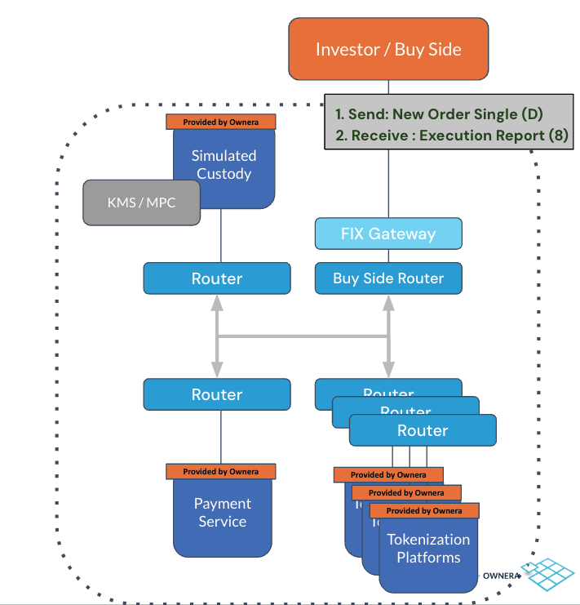
FIX Sandbox

Slide 16
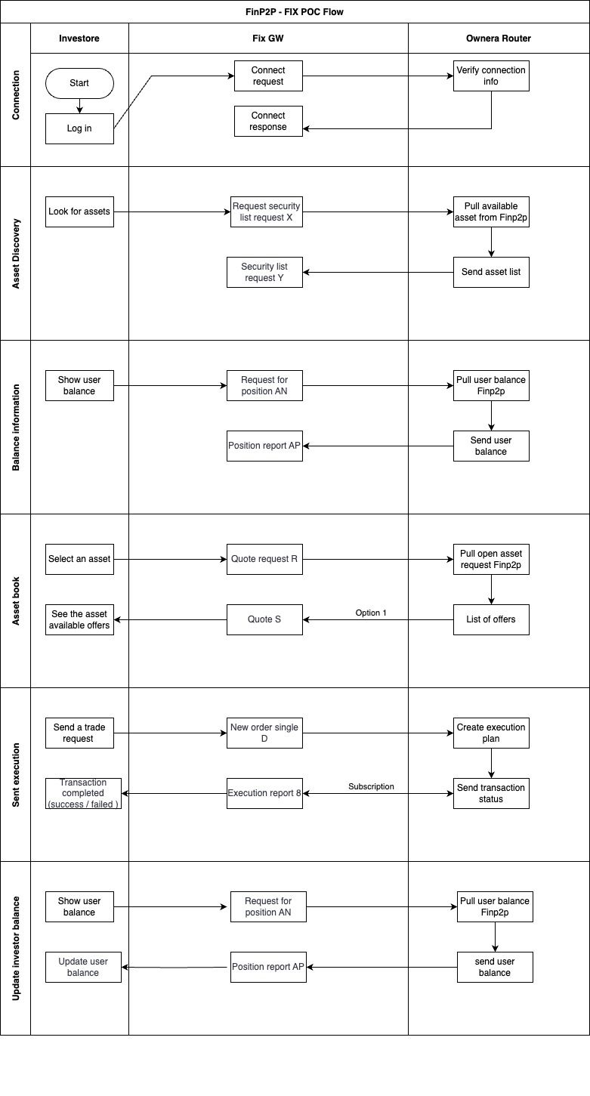
FIX Flows

Slide 17
FIX Flows

Slide 18
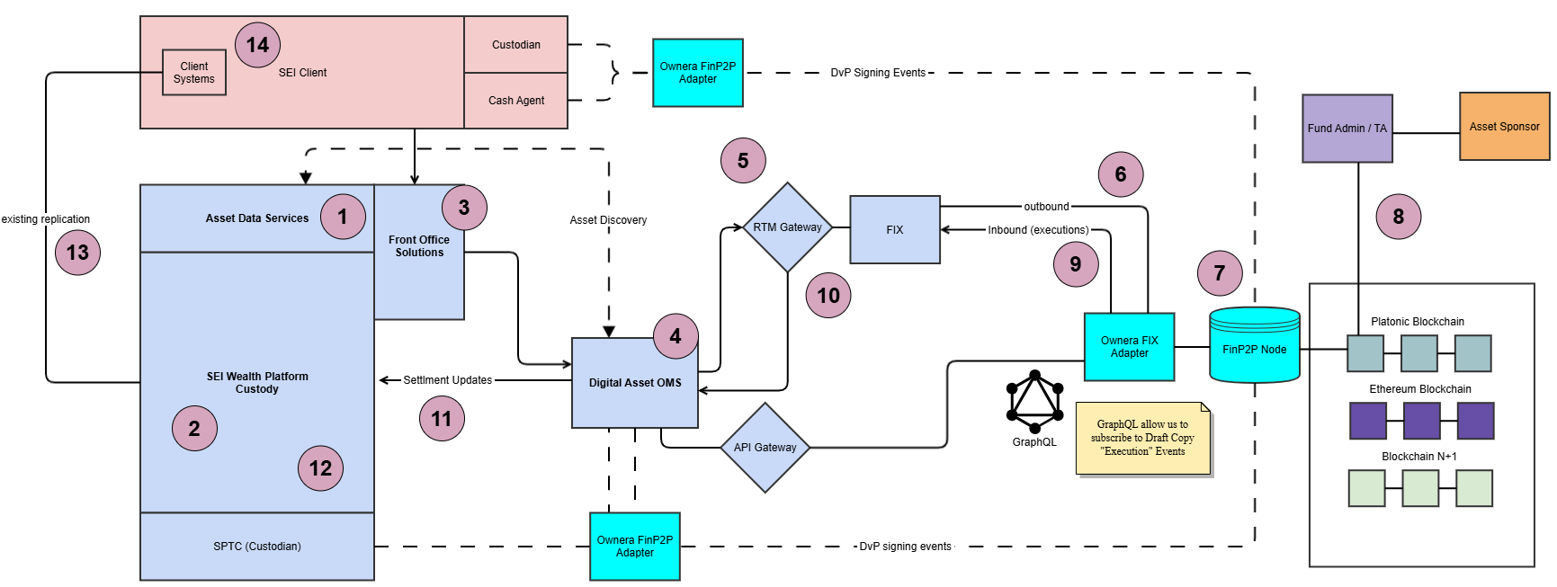
Interoperability conceptual flow visualization.

Slide 19
Collateral Mobility and Intraday Repo
Use cases:
Repo: Enabling cross market intraday Repo across banks, tokenized collateral, tokenized cash and trading platforms. Target: by-the-minute intraday repo.
Accepting tokenized assets as collateral: working with dozens of financial institutions to start accepting tokenized assets as collateral, starting with tokenized market funds. Target: instant settlement of collateral movement between parties.
Interconnecting legacy and tokenized markets: enabling the locking of traditional assets at the CSD level and reissuing them in tokenized form for instant collateral mobility into any other platform (on-chain or legacy). Target: supporting the tokenization of tens of trillions of dollars worth of asset for collateral mobility use cases.

Slide 20
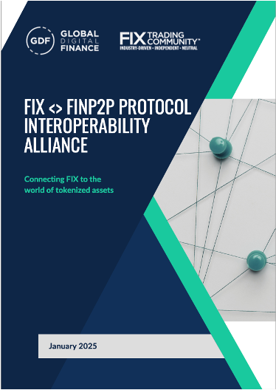
Download the White paper & Contact Us
Download the White paper:
https://www.gdf.io/resources/fix-finp2p-protocol-interoperability-alliance-white-paper/
Contact Us
Ownera:
Ami Ben David ami@ownera.io
SEI:
Justin Hayer jhayer@seic.com

Slide 21
DTCC Collateral Mobility - “The Great Collateral Experiment”
See the future of collateral mobility, brought to you by Nadine Chakar, Dan Doney and their incredible team - with interoperability by Ownera. With DTCC overseeing around $100 trillion in assets, the potential is truly beyond imagination.
Wednesday, April 23, 2025
Register now!

Slide 22
Disclaimer
Ownera is a technology company offering innovative software solutions, and is not a regulated investment company.
This document is strictly confidential and crafted exclusively for the informational use of its intended recipients. It delves into potential uses of Ownera routers within financial markets but must not be distributed or shared outside of its intended audience. This communication does not serve as an invitation or an offer to buy or sell any securities, nor should it be interpreted as financial advice or a recommendation. Recipients should not place reliance on its contents without further personal evaluation.
Potential investors are urged to conduct comprehensive due diligence and seek professional consultation before making any investment decisions. Ownera disclaims any liability for losses or damages incurred as a result of utilizing the information herein. The distribution or sharing of this material with unauthorized parties is strictly prohibited and may be unlawful.

